Slide 1
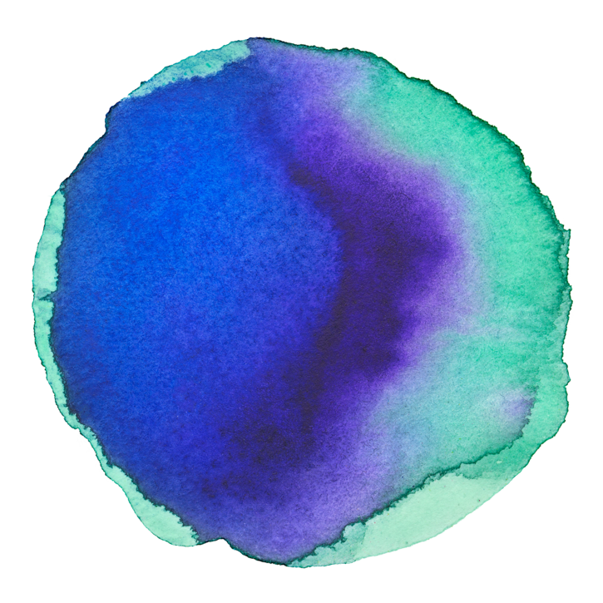
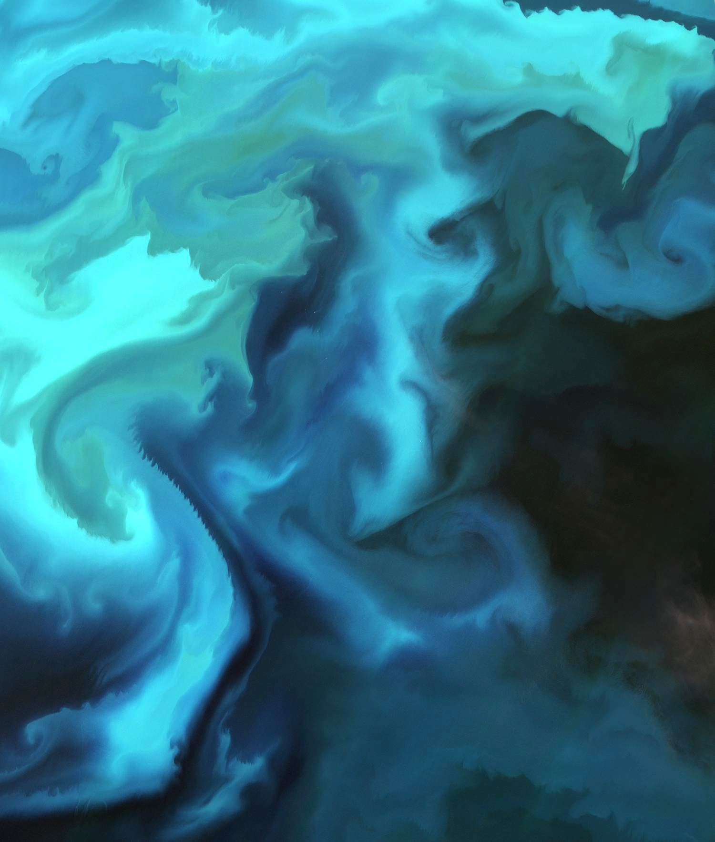
OceanBlooms
Kaitlin Harrison | Oceanography , UW
Rachel Liu | Oceanography , UW
Sarah Tanja | SAFS , UW
A phytoplankton game, adapted from Wingspan

Slide 2
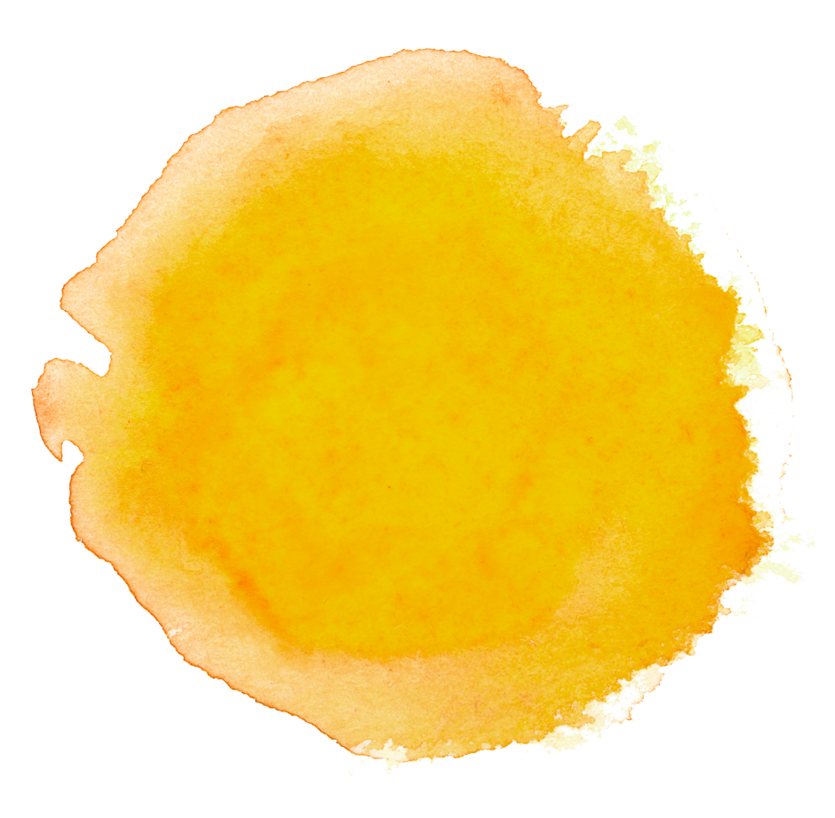

BIG TITLE
The marketing mix is a business tool used in marketing and by marketers.
Designed by Elizabeth Hargrave
Illustrated by Natalia Rojas, Ana Maria Martinez Jaramillo, and Beth Sobel

Slide 3
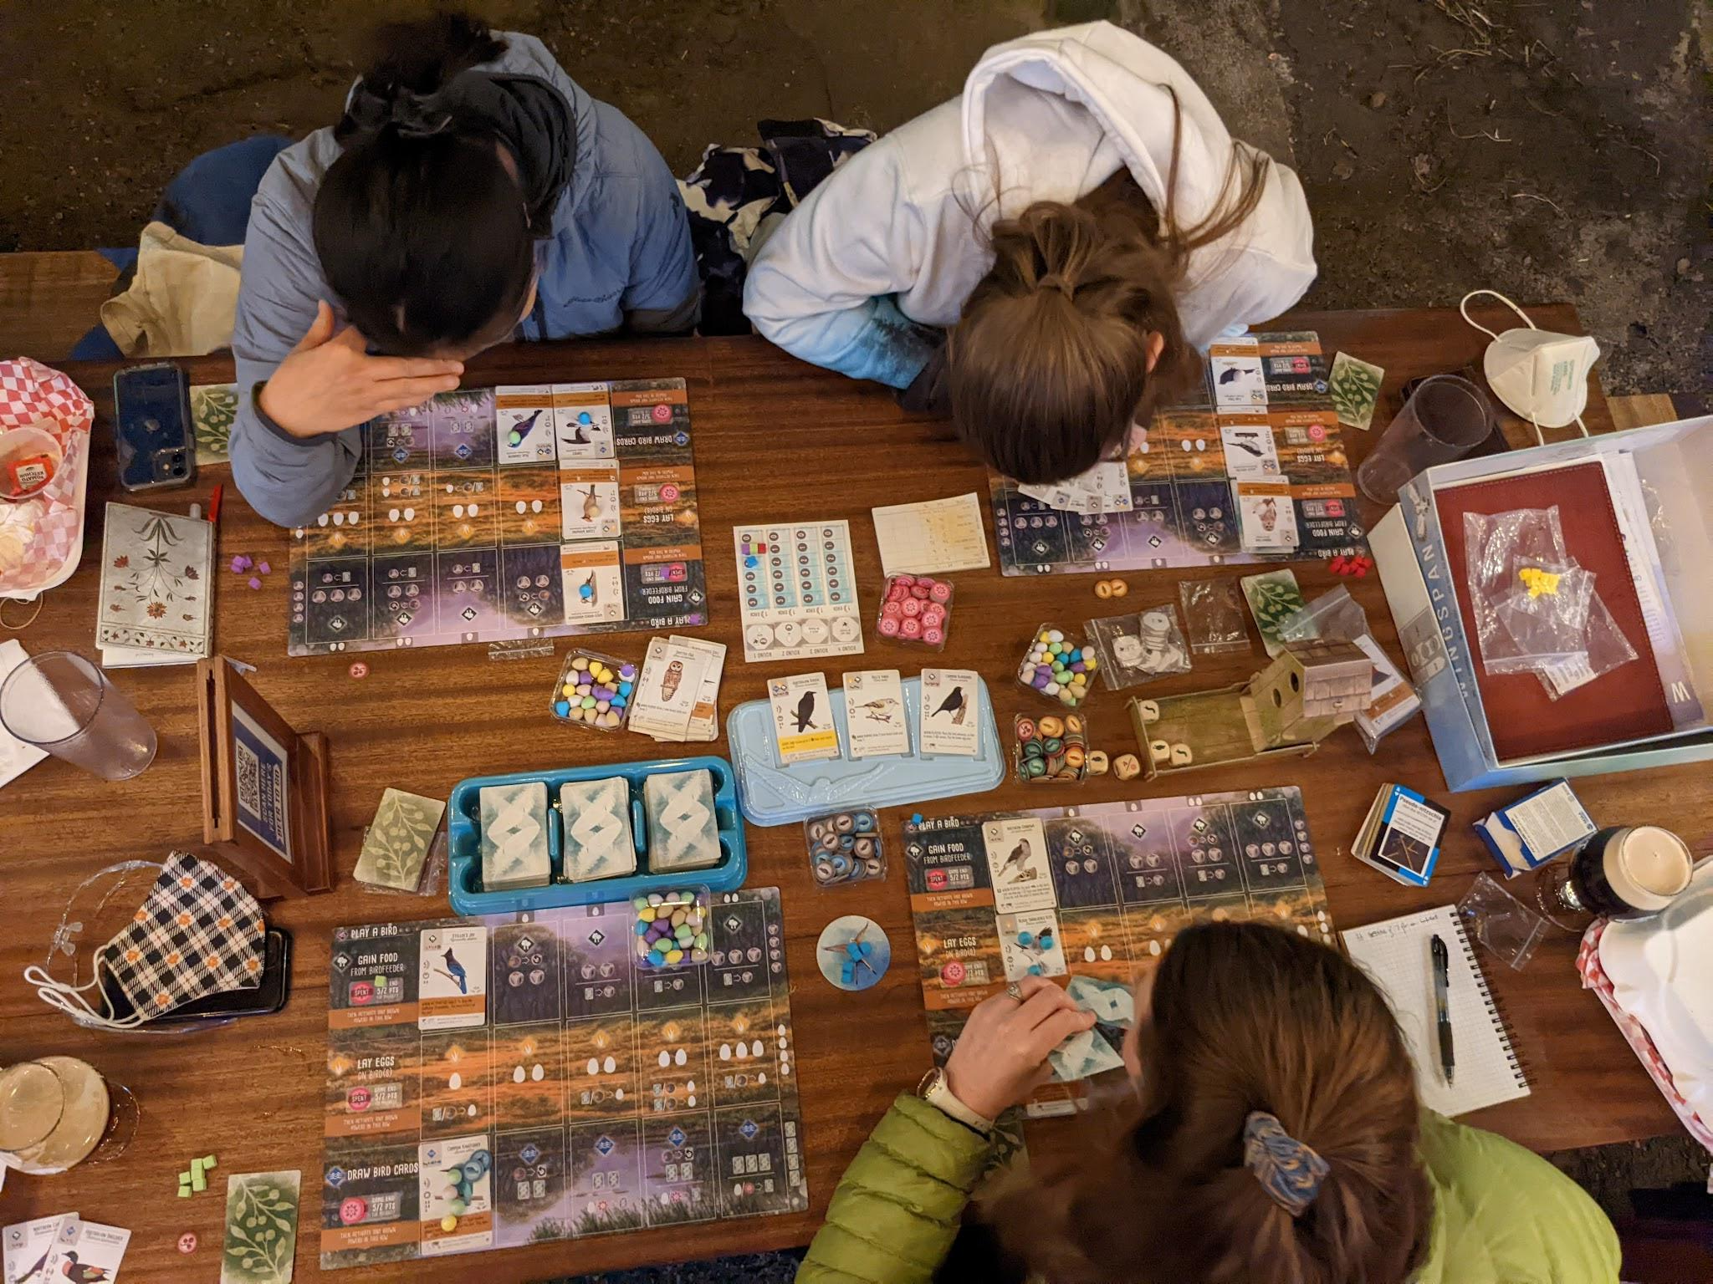
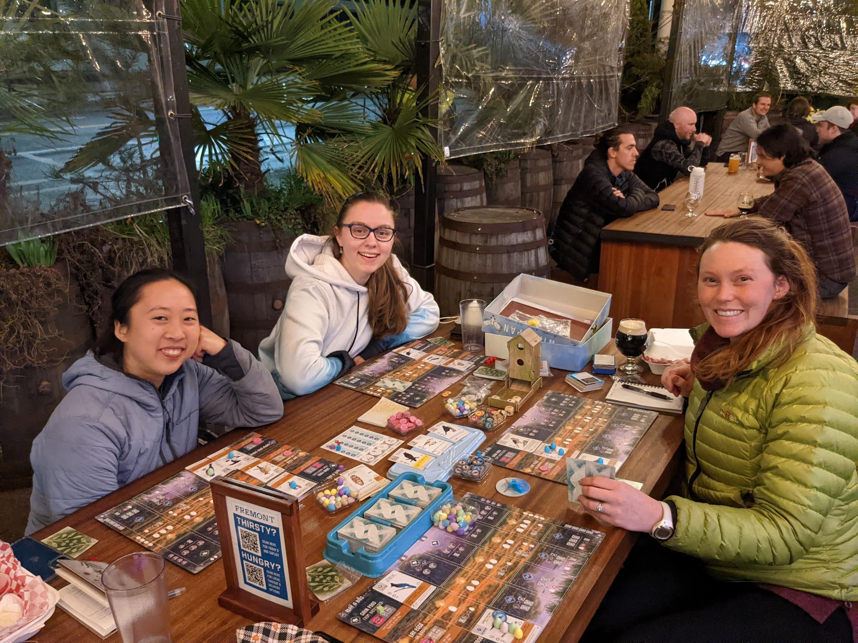
Wingspan

Slide 4
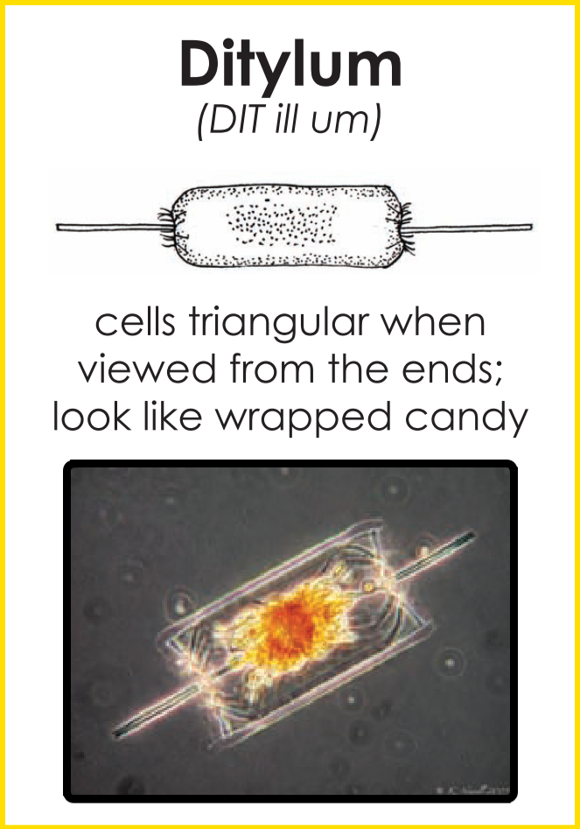

Wingspan
Phytoplankton Flash
habitats!
https://akffa.files.wordpress.com/2013/02/phytoplankton-fash-cards.pdf

Slide 5
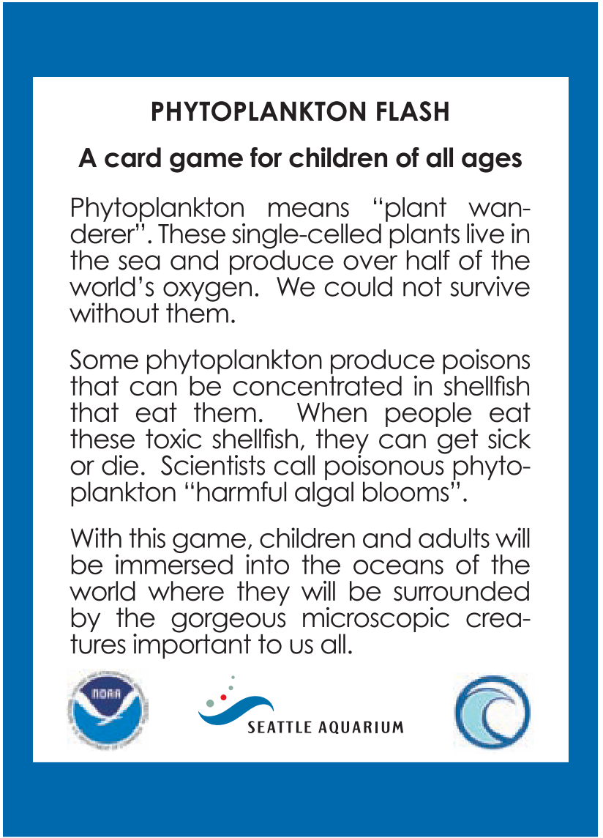
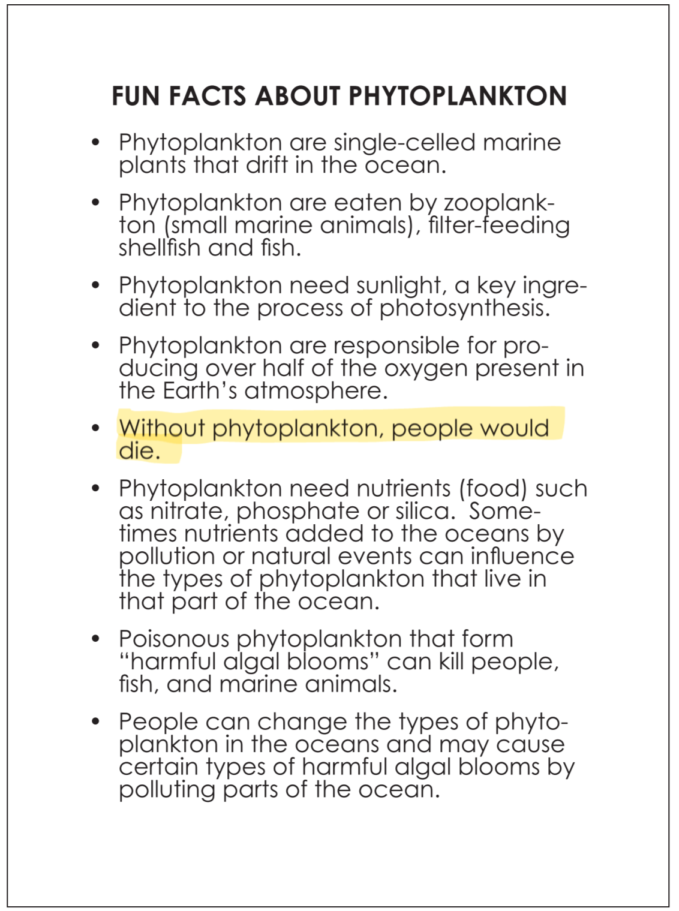
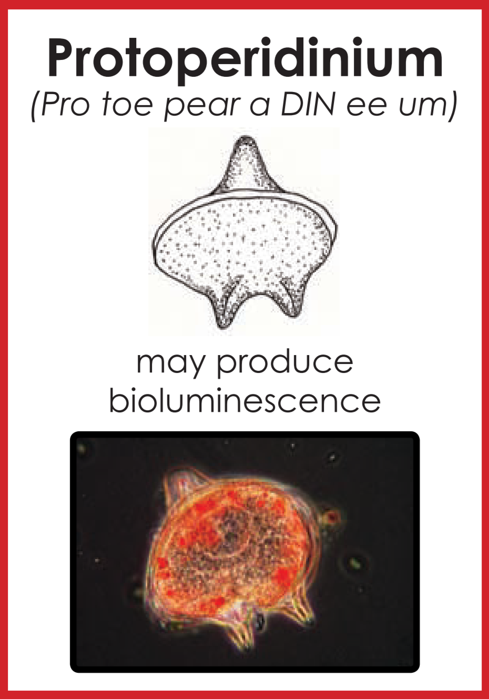
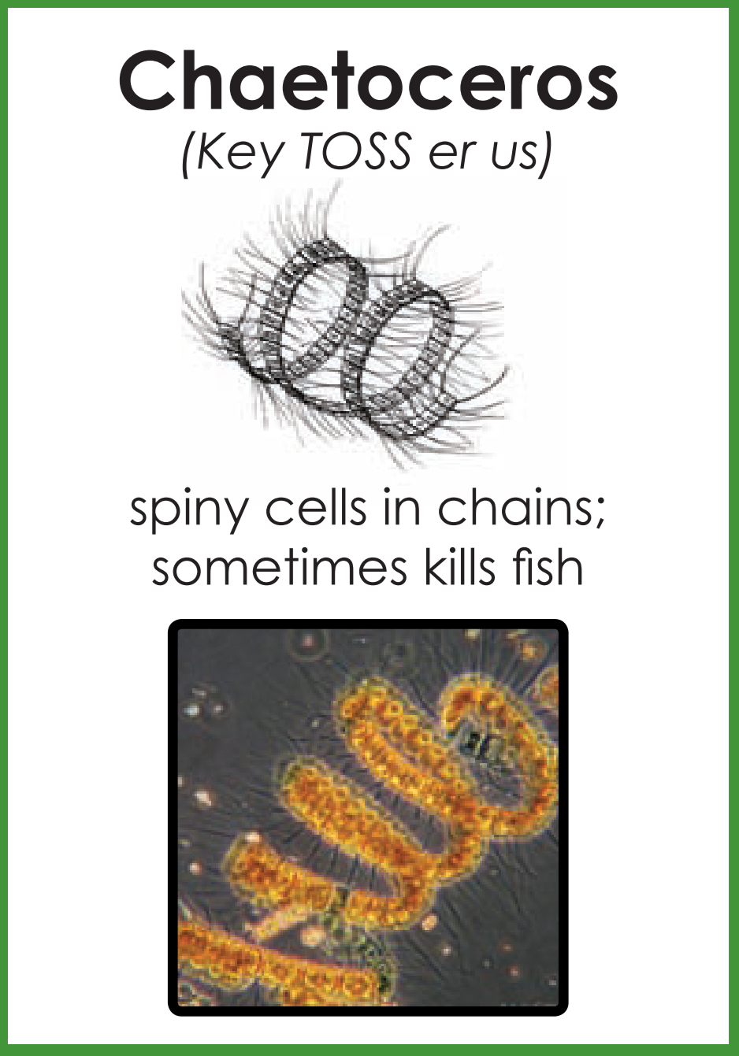
Phytoplankton Flash
Phytoplankton Flash was funded by a grant to Dr. Vera Trainer at NOAA’s NFSC (www.nwfsc.noaa.gov/hab). We thank Dr. Rita Horner (University of Washington) and Sheryl Day (NOAA) for the card design; Kathleen K. Newell (University of Washing - ton), Brian Bill (NOAA) for the phytoplankton photographs, and Catie Bursch for the illustrations.
https://akffa.files.wordpress.com/2013/02/phytoplankton-fash-cards.pdf

Slide 6
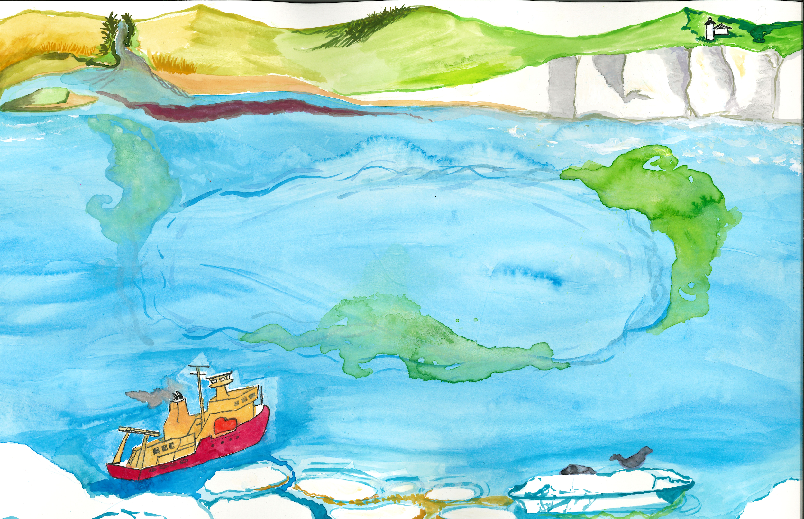
“Ocean Bloom” Game Premise
You are a research scientist studying phytoplankton in the ocean in order to understand their growth patterns and conditions.
You were recently given the funding and opportunity to plan three cruises around the oceans to sample and study phytoplankton!
There are different benefits to studying phytoplankton in each area of the ocean, but plan carefully, as you can only stop in five locations each cruise.

Slide 7
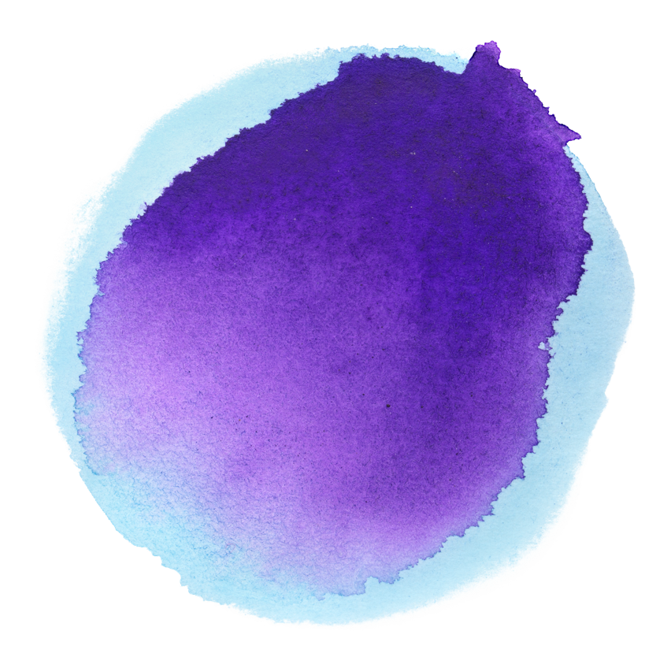
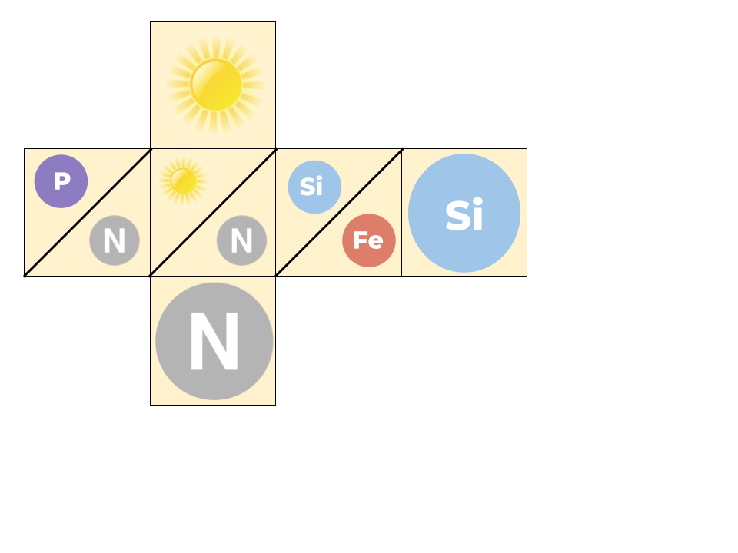
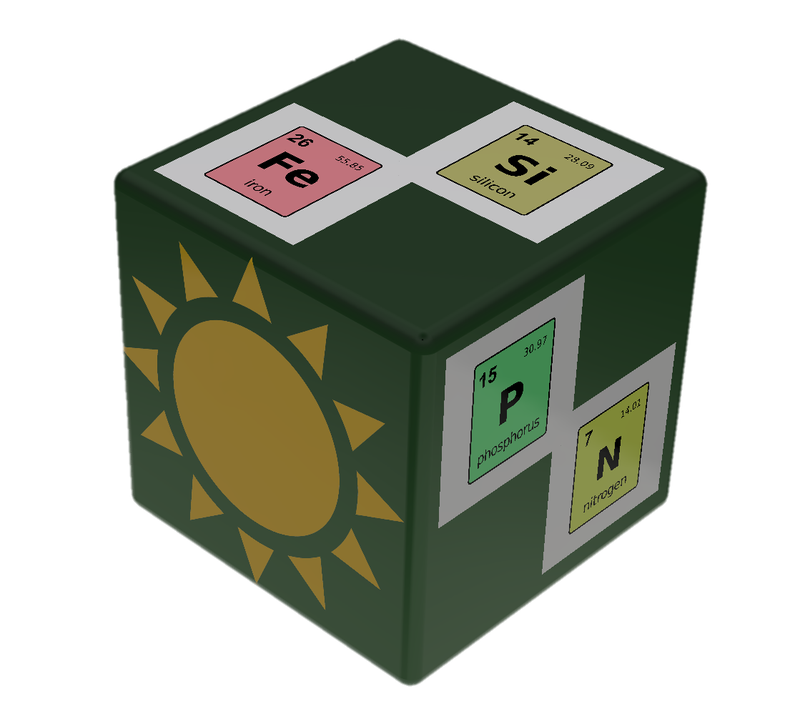
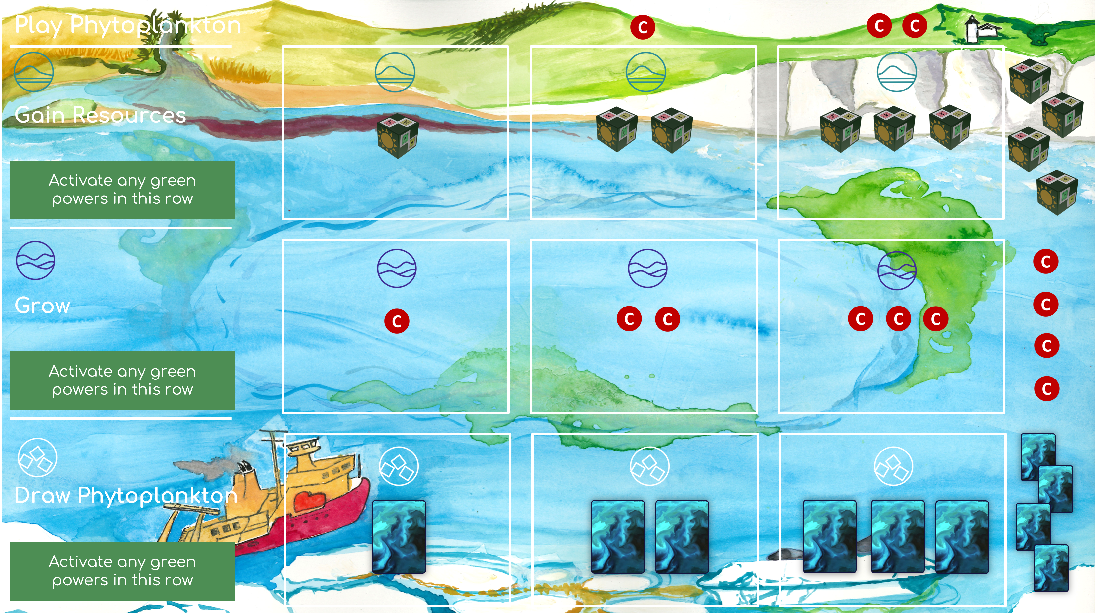
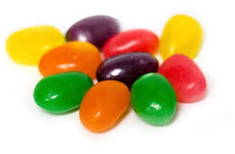

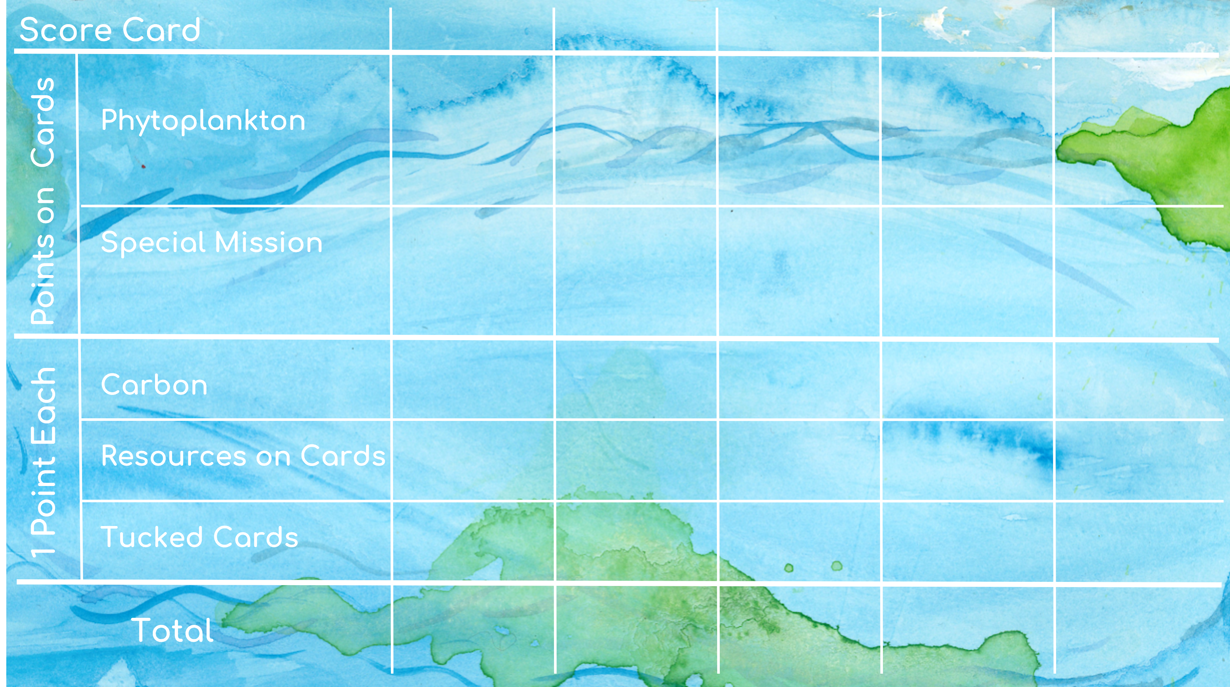

Game Components:
Per Group of 2-5 players
25 Phytoplankton Cards
5 Resource Dice
Resources - jellybeans
Light - yellow
Nitrogen - green
Phosphorus - purple
Iron - orange
Silica - blue
Carbon – red jellybeans
1 Ocean Region player mat per player
1 Score Card

Slide 8

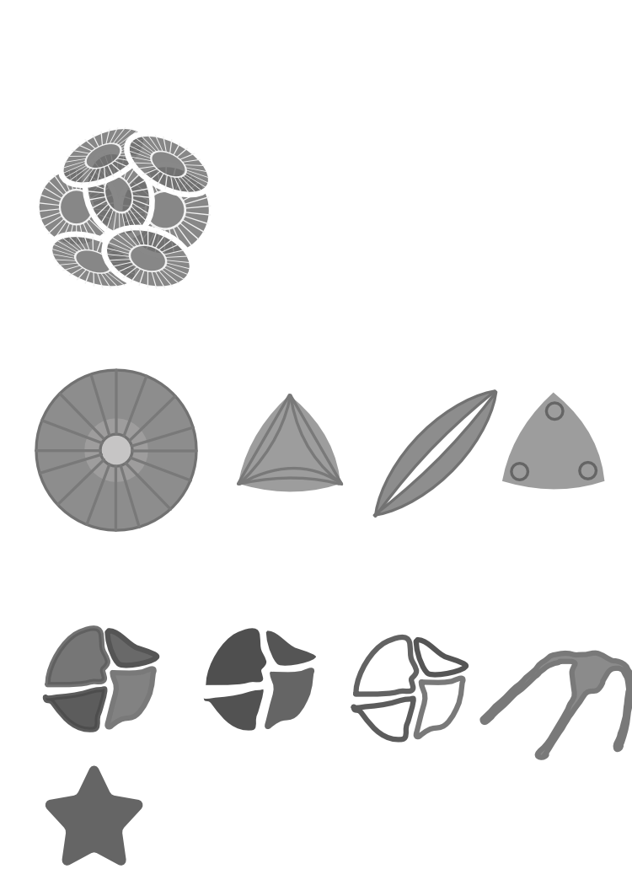
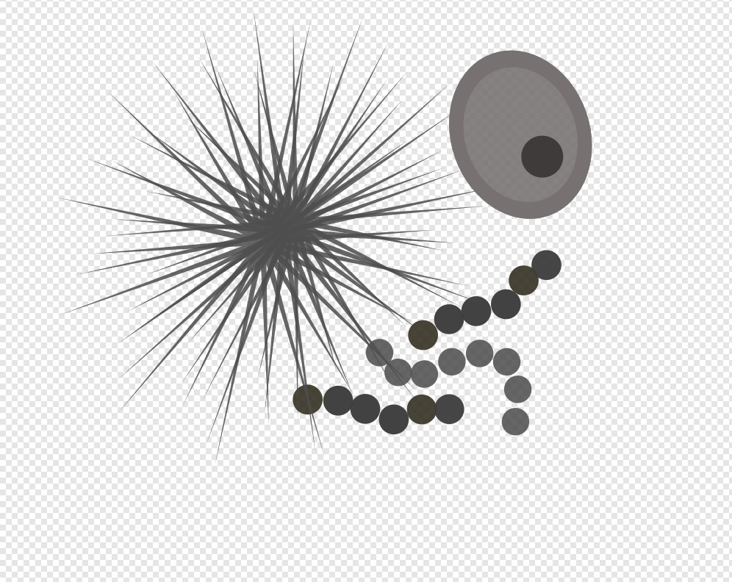
Find phytoplankton
Watch them grow
Gain resources needed for them to thrive, and arrange the perfect conditions for certain species to BLOOM

Slide 9
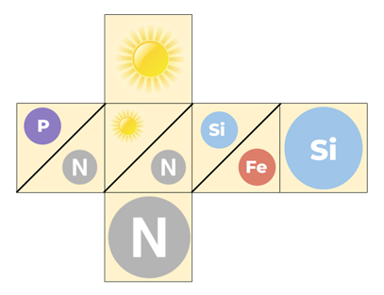

Slide 10
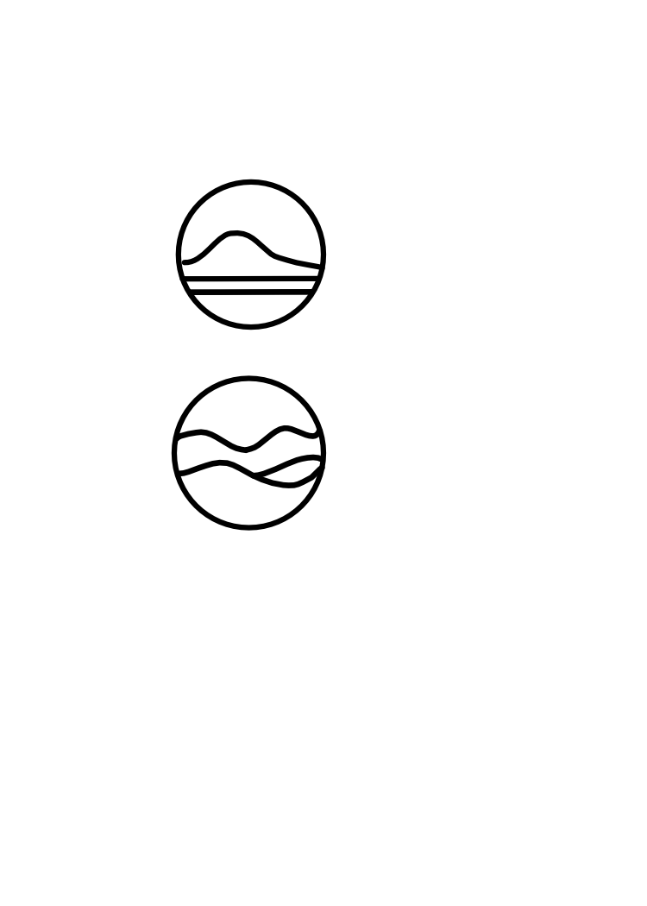
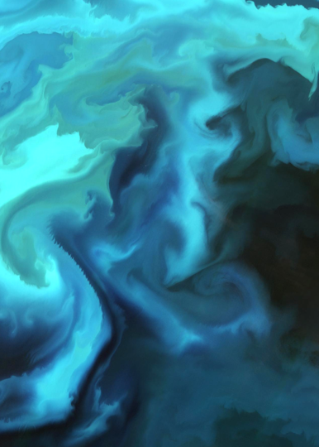
Play Phytoplankton
Gain Resources
Activate any green powers in this row
Grow
Activate any green powers in this row
Draw Phytoplankton
Activate any green powers in this row

Slide 11
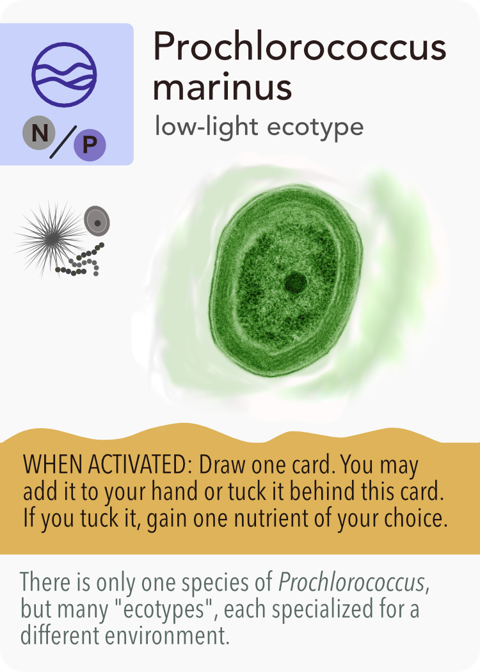

Slide 12
Score Card
Phytoplankton
Points on Cards
Special Mission
Carbon
1 Point Each
Resources on Cards
Tucked Cards
Total

Slide 13
Score Card
Phytoplankton
Points on Cards
Special Mission
Carbon
1 Point Each
Resources on Cards
Tucked Cards
Total

Slide 14
At each station, you can choose
to do 1 of 4 possible actions:
1 - Play Phytoplankton
2 - Gain Resources
3 - Grow from Photosynthesis
4 - Sample Phytoplankton

Slide 15
Your Objectives:
Collect phytoplankton
Gain resources
Trigger a BLOOM!

Slide 16
In order to experience the effects of a BLOOM, the conditions have to be just right
Each phytoplankton collected has special powers and requires specific resources to BLOOM

